Slide 1

AIRBNB HOTEL BOOKING ANALYSIS
VINUTNA SATYA VANI
Internship ID:
INTERNSHIP_17546440516895be537820f

Slide 2

PROBLEM STATEMENT
The Problem: The short-term rental market is highly competitive. Hosts struggle with optimizing pricing, setting minimum stay requirements, and maximizing occupancy. Guests face difficulty identifying the best value and understanding booking patterns across different neighborhoods and property types.
The System: A comprehensive booking analysis system that processes Airbnb booking data to reveal critical insights into stay durations, pricing strategies, neighborhood demand, and host activity, enabling data-driven decisions for both hosts and guests.

Slide 3
Project Description
Objective: To analyze booking patterns and market dynamics in Airbnb's NYC listings to optimize host strategies and guide guest choices.
Data Source: Airbnb Open Data (102,599 initial listings with booking-related features).
Methodology:
Data Cleaning: Handled duplicates, missing values in key booking fields (availability_365, reviews), and standardized price/fee formats.
Booking Analysis: Focused on stay duration, availability, review patterns, and host listing strategies.
Core Questions Answered:
What are the typical minimum stay requirements?
How available are properties throughout the year?
Which property types and neighborhoods have the highest booking potential?
What pricing strategies are most effective?

Slide 4

WHO ARE THE END USERS?
Airbnb Hosts & Property Managers:
To determine optimal minimum night stays and pricing strategies
To understand occupancy rates and availability patterns
To benchmark their listing performance against market averages
Travelers & Guests:
To understand typical stay requirements in different neighborhoods
To identify areas with better availability and review ratings
To make informed decisions about booking duration and location
Airbnb Platform:
To identify market trends and improve booking recommendations
To develop better host tools for pricing and availability management

Slide 5

Technology Used
Programming Language: Python
Core Libraries & Tools:
Pandas & NumPy: For data cleaning and numerical analysis of booking metrics
Matplotlib & Seaborn: For visualizing booking patterns and price distributions
Jupyter Notebook: For interactive analysis and documentation
Key Analysis Techniques:
Data cleaning and preprocessing
Statistical analysis of booking metrics
Market segmentation analysis
Data visualization for pattern recognition

Slide 6
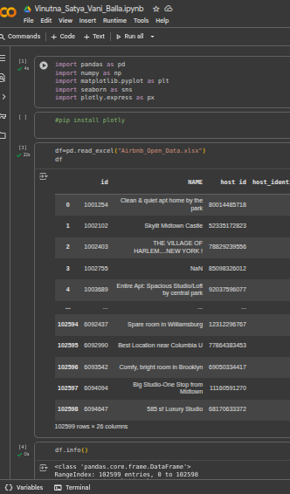
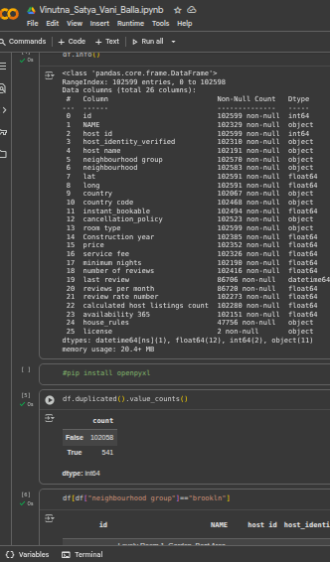
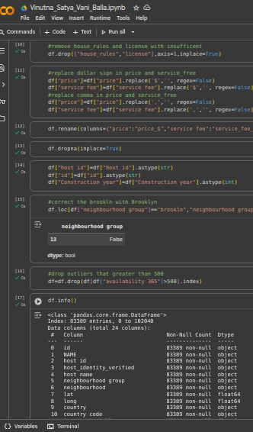
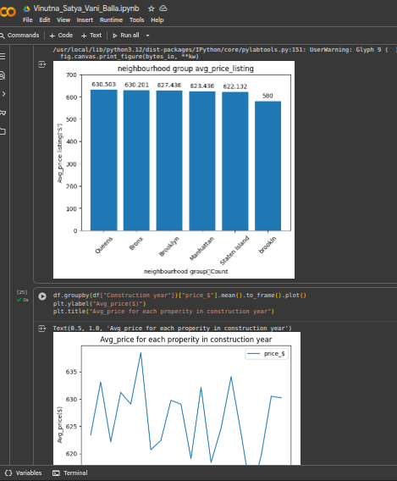
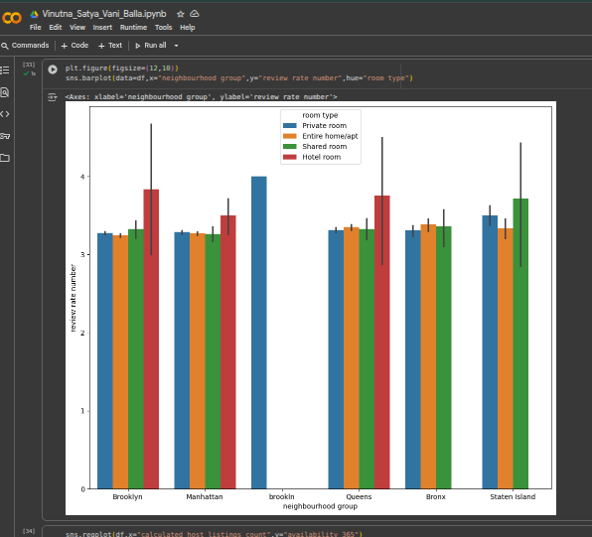
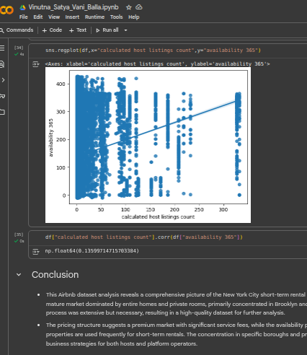
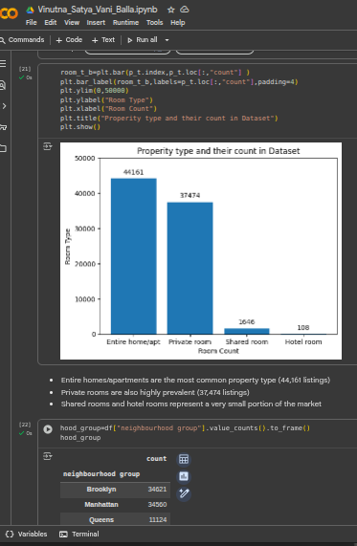
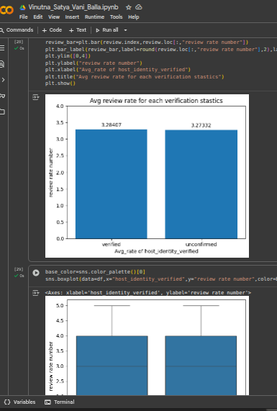
Screenshots of code
Demo Link

Slide 7
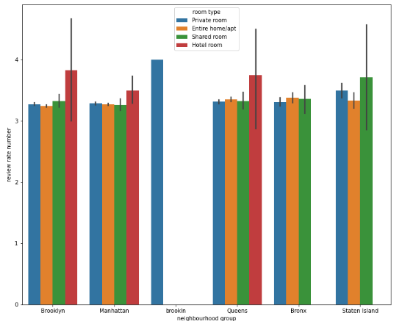
Screenshots of Output
Demo Link

Slide 8
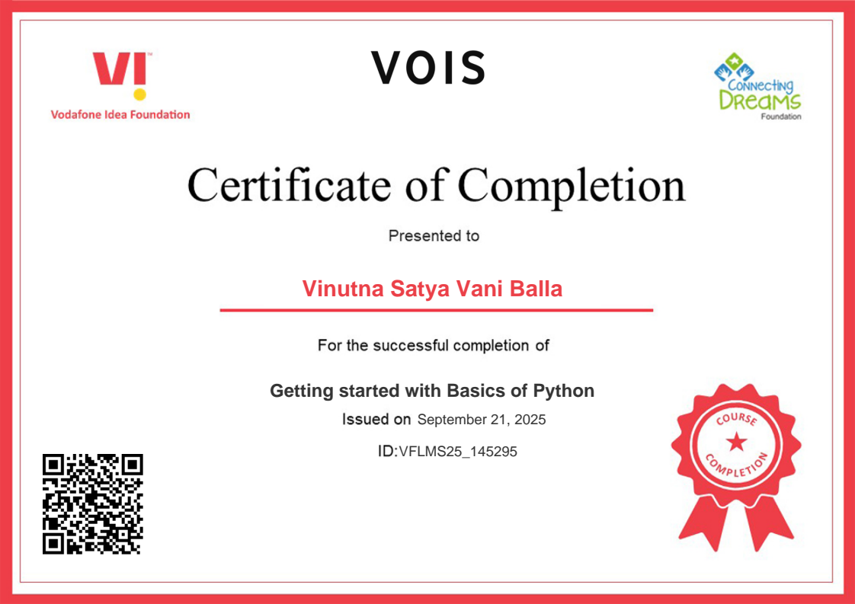
Getting started with Basics of Python Certificate
Demo Link

Slide 9

Data Visualization Certificate
Demo Link

Slide 10
GitHub Repository
https://github.com/vani514/VOIS_AICTE_OCT2025_Vinutna_Satya_Vani_Balla.git
Demo Link

Slide 11
Thank you
.
.

